Slide 1
JENNIFER MACALI, DNP, MPH, RN
ASSOCIATE PROFESSOR, COLLEGE OF NURSING
Sustainability Concepts - Health Science Education
Notes:
Preparing for this I reflected on why I am called to this work and here is what I came up withMy family exemplified "Leave a space better than you find it"Background - Italian American, farmers, masons, teachers, cared about living well day to day. Grew up gardening and cooking. Eventually worked as a community health worker in Toledo, Ohio and realized I wanted the opportunity to do more. While spending time caring for small plots of land I was exposed to the environment and noticed that waste disposed of in places far removed from where I get water, food and air eventually make it to spaces that are natural and pure; Therefore We/I eventually get exposed to products created by humans that are not intended for consumption or exposure. That said I began my journey into healthcare in health education as a community health work, with an emphasis on prevention/public health, and behavior change. At that point, I didn't as fully acknowledge the environment physical and social as influential as I do now. Now we know we are deeply connected to both, physical, social environments and this influences our health, wellness, and longevity.Robin Wall Kimmerer Says ""It's who we are - we are inseparable from the land, both in body and in spirit" - Robin Wall Kimmerer, 2013This very much resonates with my natural thought process and should be sufficient to highlight why sustainability concepts in higher education is so vitally important. If that isn't significant enough the WHO has identified the Climate crisis as the single biggest health threat facing humanity"Climate Crisis "Single biggest health threat facing humanity" - WHO, 2021These are some of the reasons I am called and passionate about this work.

Slide 2
Healthcare Emissions Globally 4.6%
Notes:
4.6% of Global Emissions come from healthcare. EU, China and US contribute to 56% of that and the US healthcare system is more carbon intense than the global average (8.5%). Inpatient healthcare is the 2nd largest commercial consumer of energy Types:Direct (company/facility/vehicles)Emissions from energy purchased by health systems (electricity, heating, cooling, steam)Indirect from production and transport (82%) - leased assets, employee/patient commuting, goods and services, transport and distribution, etc.

Slide 3
Notes:
Before I share some of my learnings I am curious how y'all think of climate, sustainability, environment etc? What comes to mind when you hear the words on the screen? What does it mean to you? What meaning do these words have to your colleagues?

Slide 4
Findings
Sustainability Concepts in Health Sciences
In the Literature
My Findings
How to Bridge the Gap?
Students are interested
Students & Faculty identify value in exposure to sustainability and the climate breakdown
Faculty interest is unclear
Call to Action
May not find value in higher education space
Many priorities
Notes:
Other thoughts from your experience discussing these topics in education and in healthcare practice settings? Exemplars, workshops, the opportunity to incorporate across campus and in personal spaces, inform leadersdesign with sustainability in mind

Slide 5
Thoughts?

Slide 6
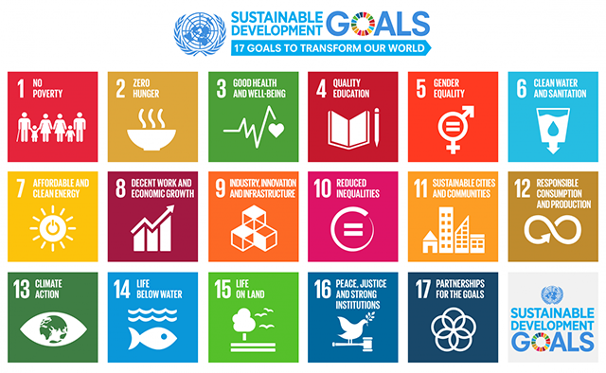
Notes:
Sustainability, environment, and climate are inextricably connected to individual and population health. The SDG categories and U of U topics organize the many categories related to impact reduction. How do you see the SDGs related to well-being, health, and longevity? Identify one SDG related to health, well-being, healthcare, long-term population health, etc. (call on those not in health science areas to see if they make other connections compared to what traditional HS folx connect)TopicsGreenhouse Gases and Human ModificationAir QualityEcological and Environmental ChangeNature and CultureEnvironmental justice is the idea that all people and communities have the right to live and thrive in safe, healthy environments with equal environmental protections and meaningful involvement in these actions.” - APHA

Slide 7
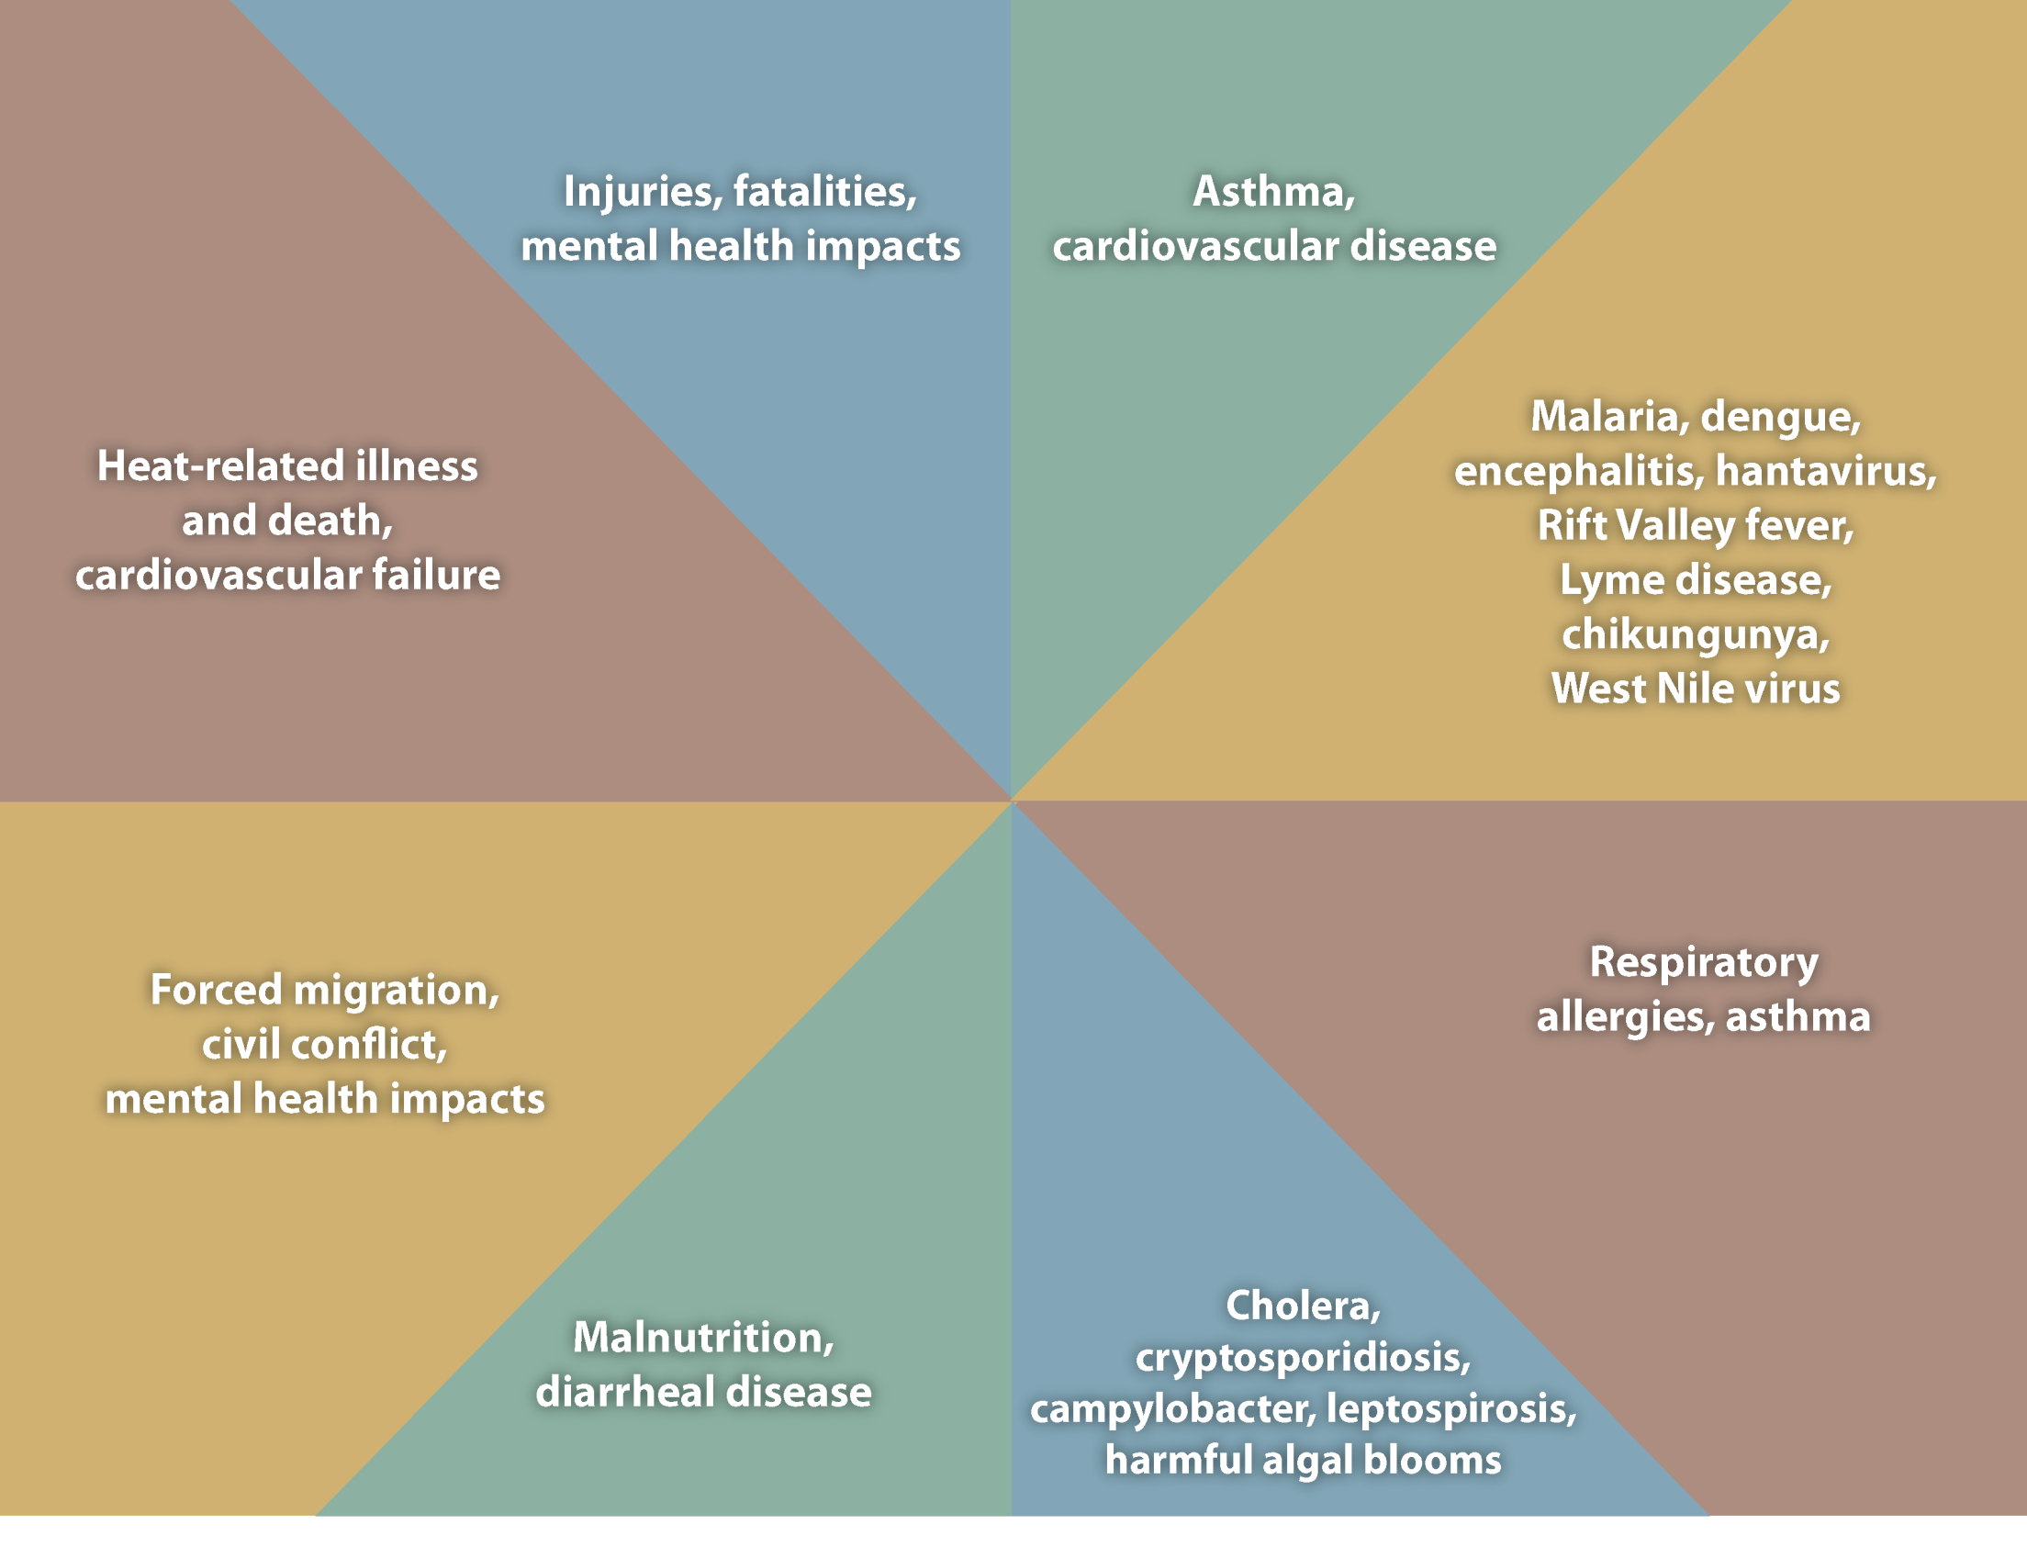
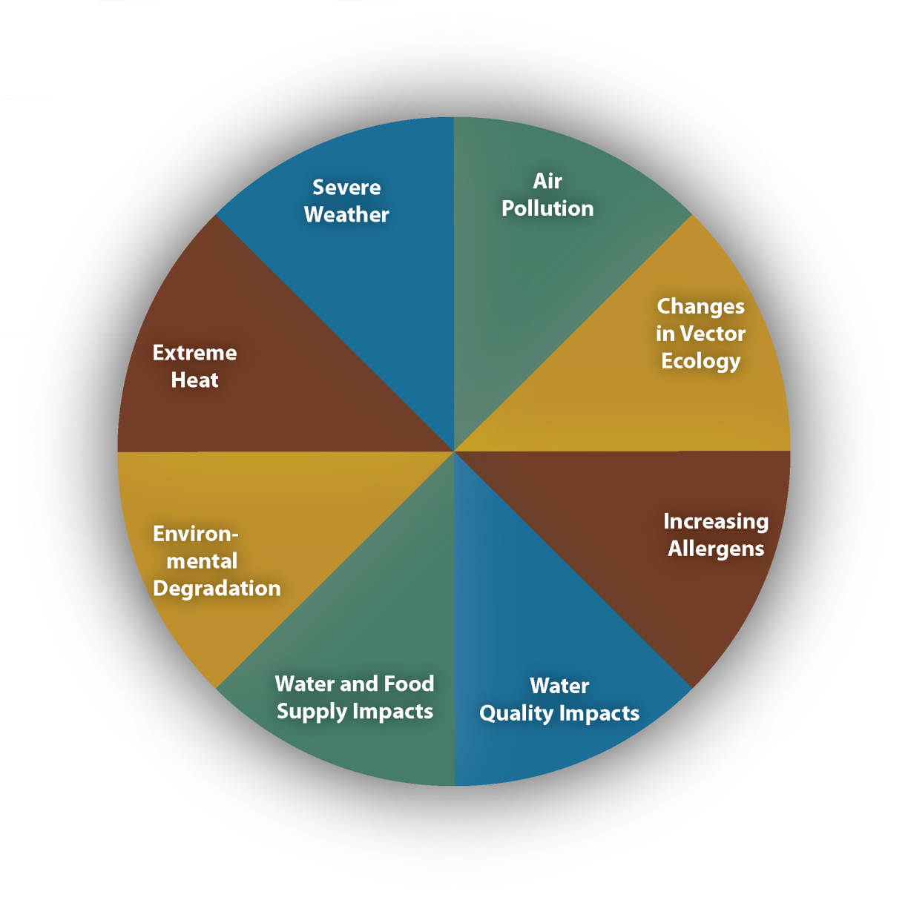
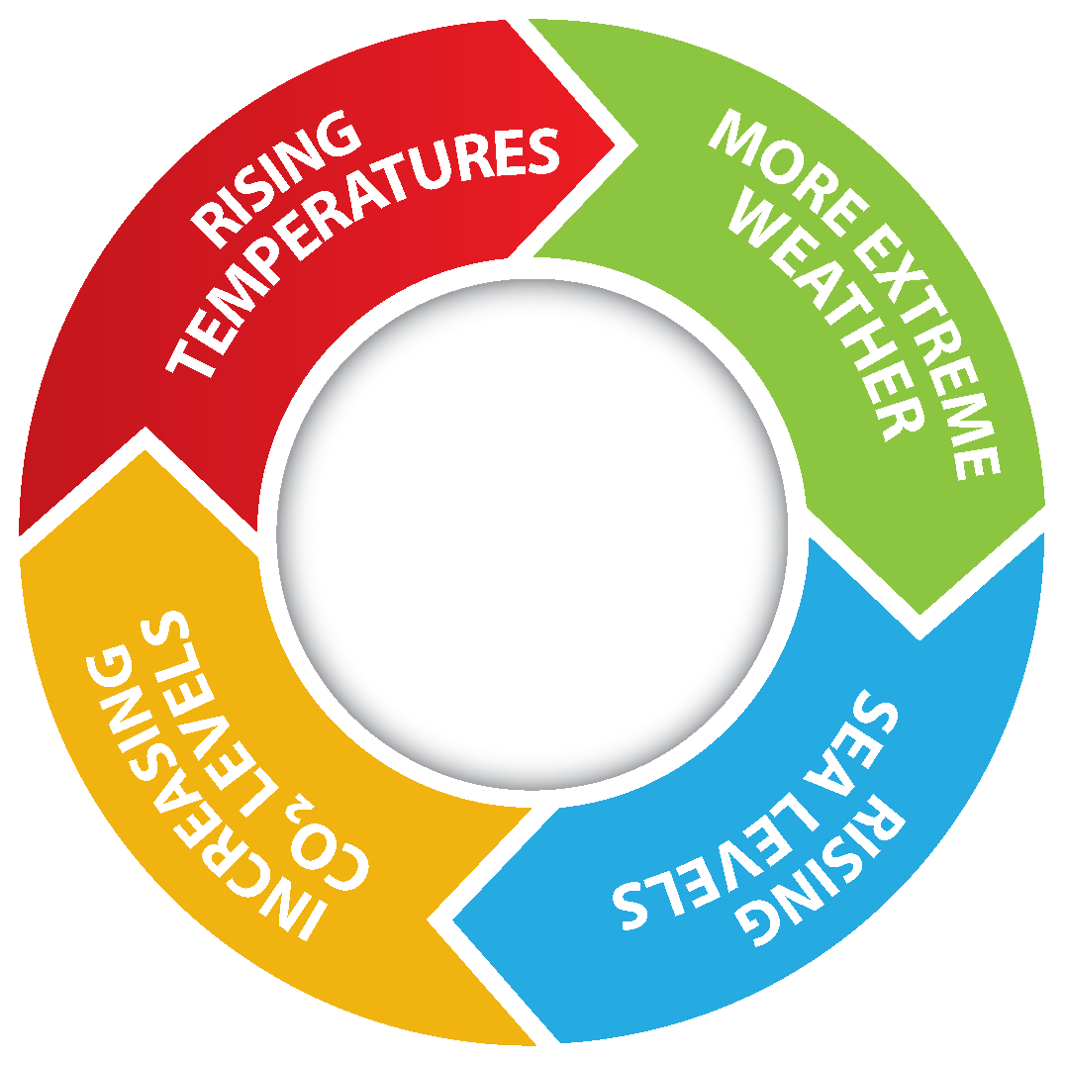
Notes:
Climate change impacts a wide-range of health outcomes. This slide illustrates the most significant climate change impacts (rising temperatures, more extreme weather, rising sea levels, and increasing carbon dioxide levels), their effect on exposures, and the subsequent health outcomes that can result from these changes in exposures.

Slide 8
What can you do by next week?
Notes:
If individuals couldn't integrate concepts into their courses what is one action to take steps toward that goal by next week? If we don't make small changes now we won't create the opportunity for young professionals to make the connection and lead change in the future.

